Slide 1
Cancer
Lesson 4.2
How do tumor cells leave home?

Slide 2
Do Now
Why would malignant cells escape the primary tumor and travel to other sites in the body?
What would be the advantage of escaping like this?
Escaping the primary site is called metastasis.

Slide 3
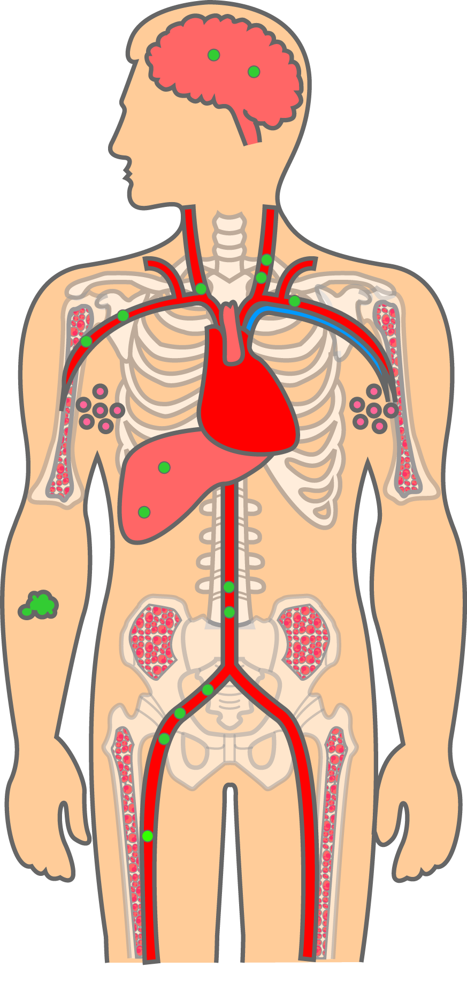
Primary vs. secondary tumors
Primary tumor in the skin
Secondary
tumors

Slide 4
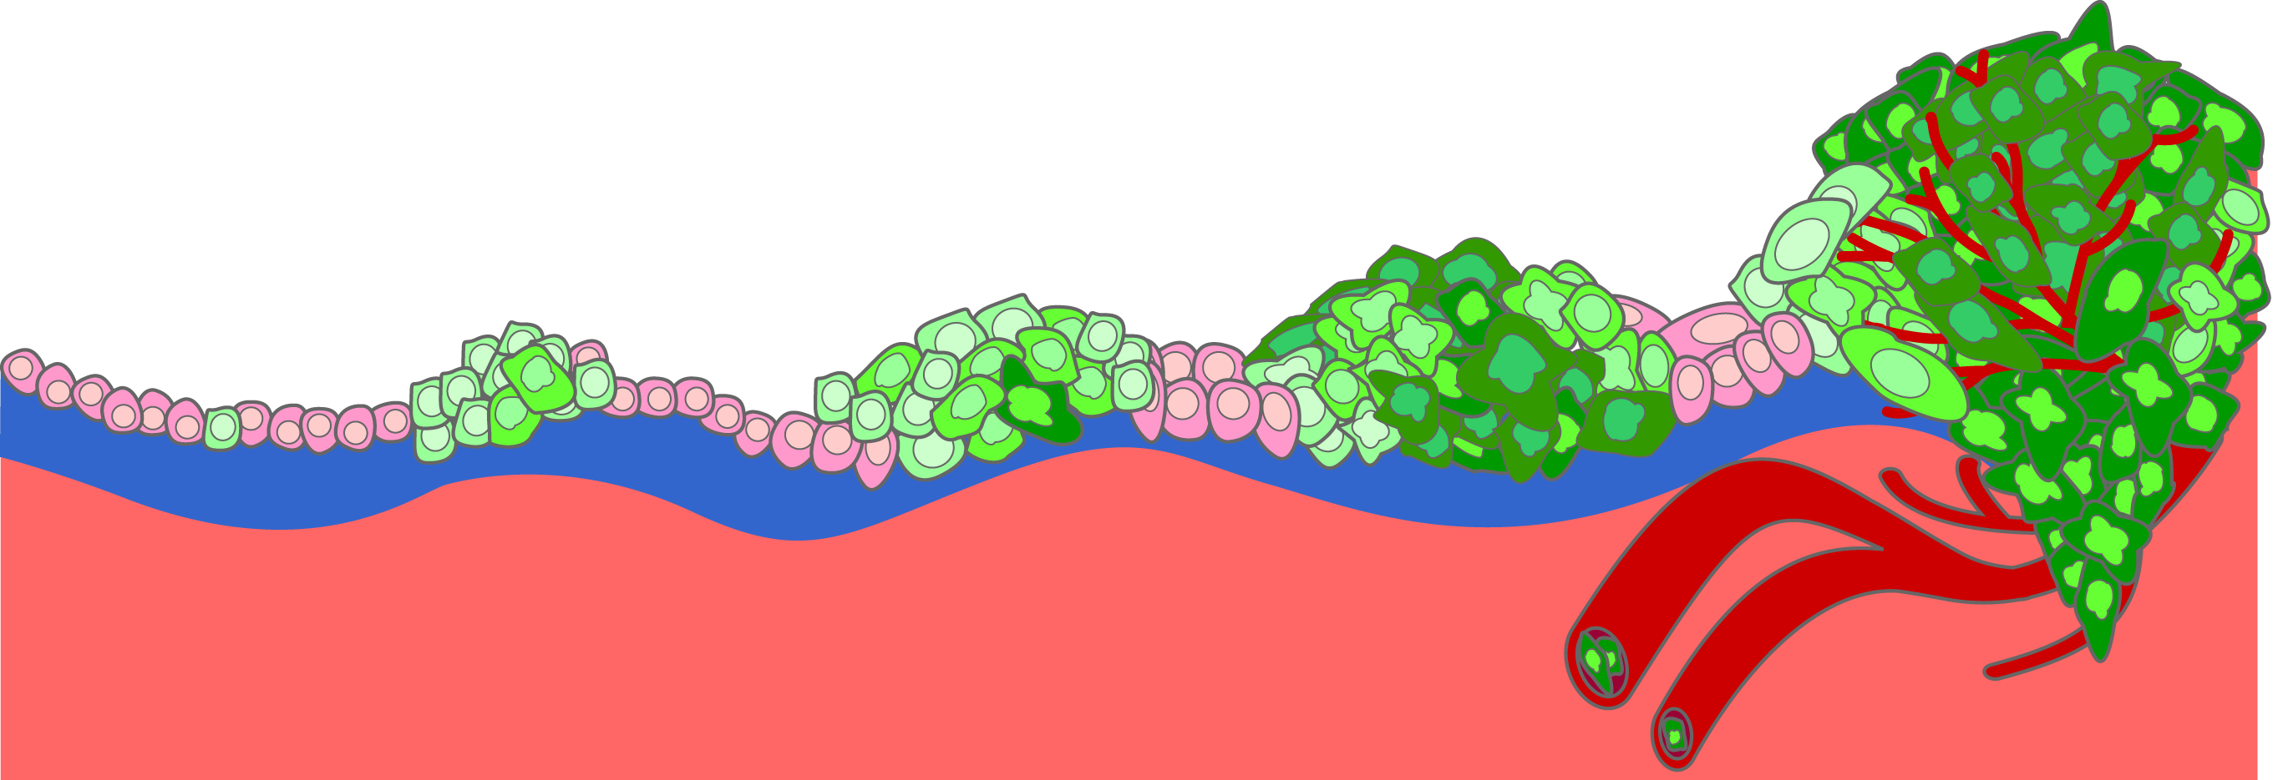
Tumor invasion
Malignant tumors can travel
to distant sites
Benign tumors grow,
But cannot migrate
Malignant tumors can invade
the stroma
Time
Malignant tumors that migrate to distant sites are said to ‘metastasize’

Slide 5
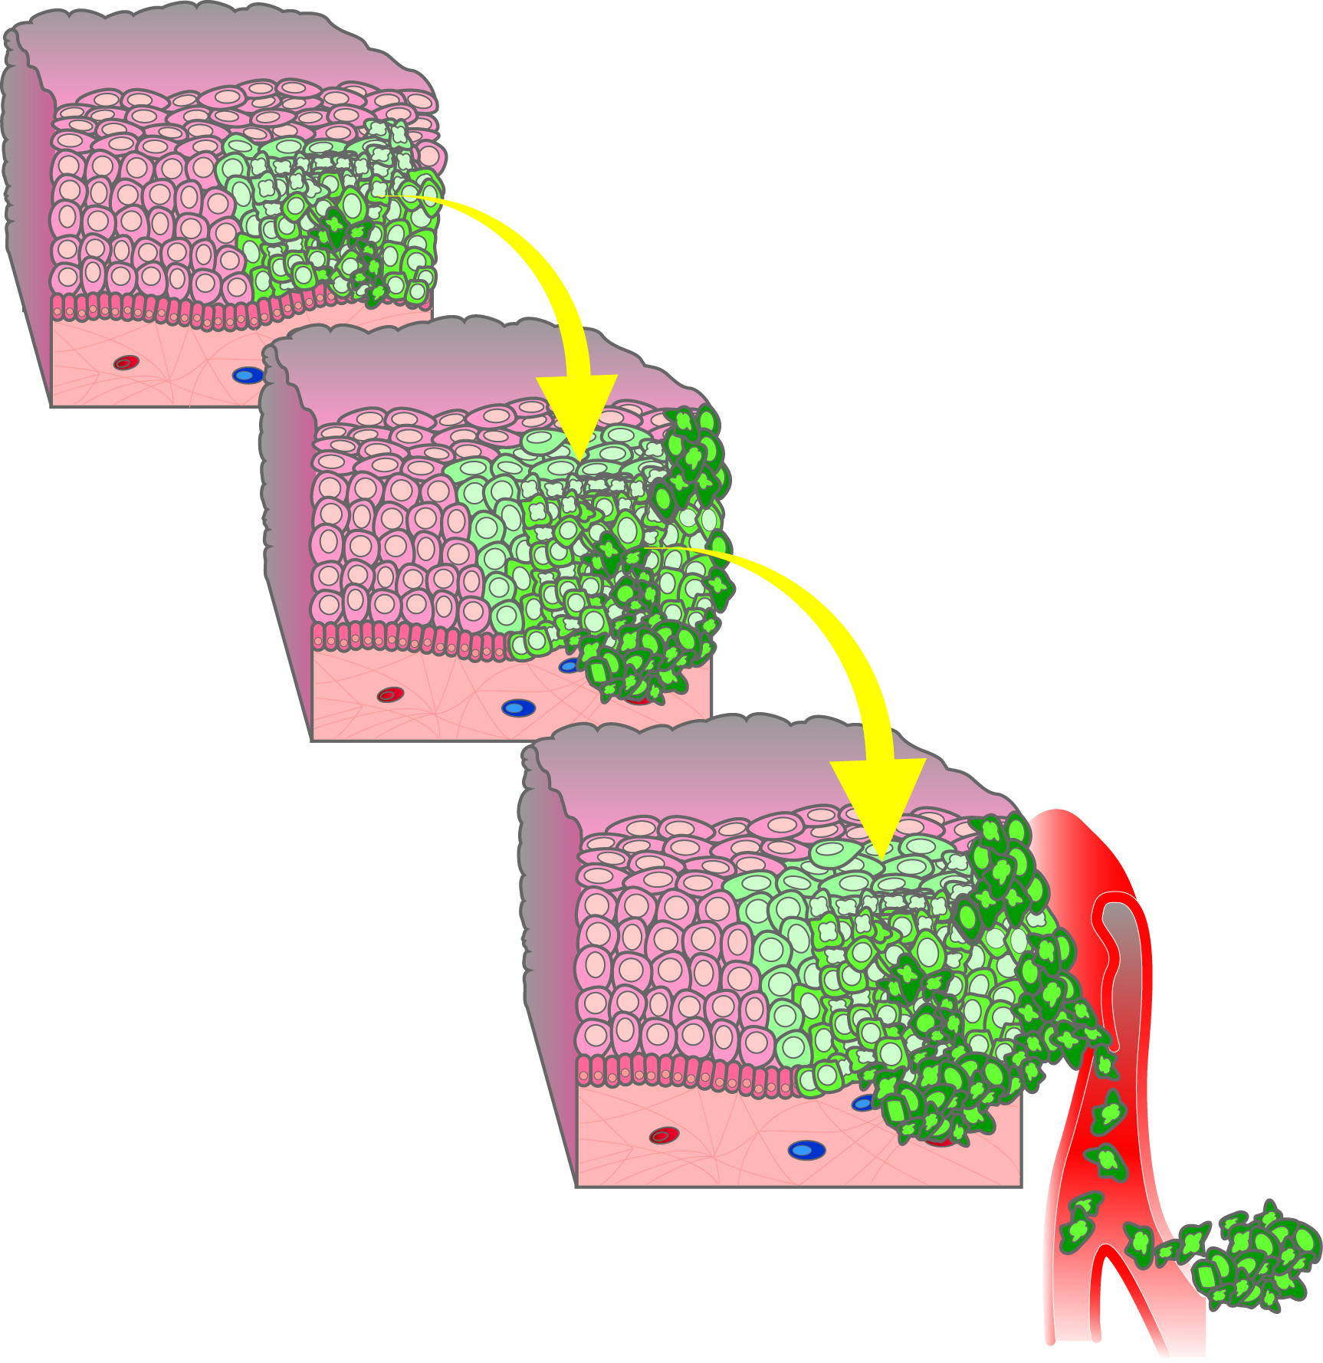
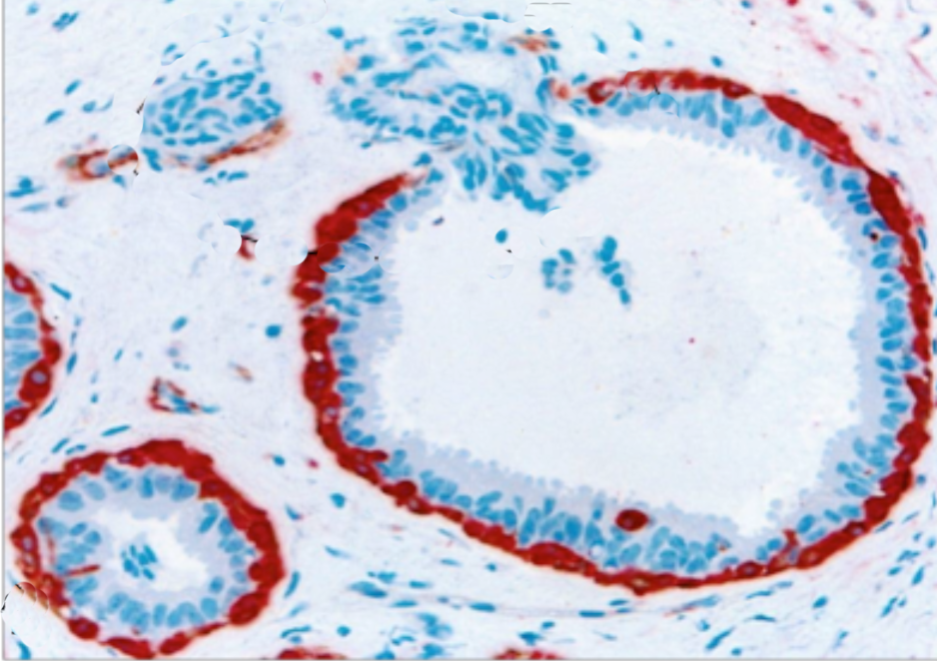
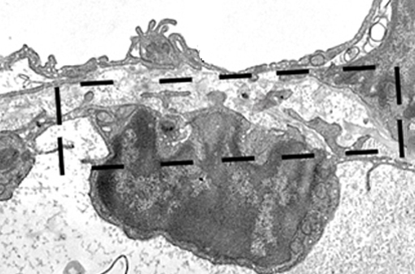
Invasion and metastasis
Basement membrane
Malignant cells
invade the stroma
Cancerous epithelial cells
Stroma
Cancer cell
Blood vessel
Intravasation
Metastatic cells spread through blood or lymph vessels

Slide 6
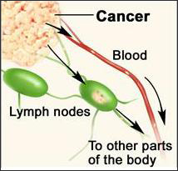
Cancer cells migrate through lymph or blood

Slide 7
Cancer metastasis is like wound healing
Epithelium
Scab
Immune cells
Stroma
Stromal tissue is loosened
Immune cells are recruited
New blood vessels are made
Immune cells and stromal cells signal epithelial cells to replicate.

Slide 8
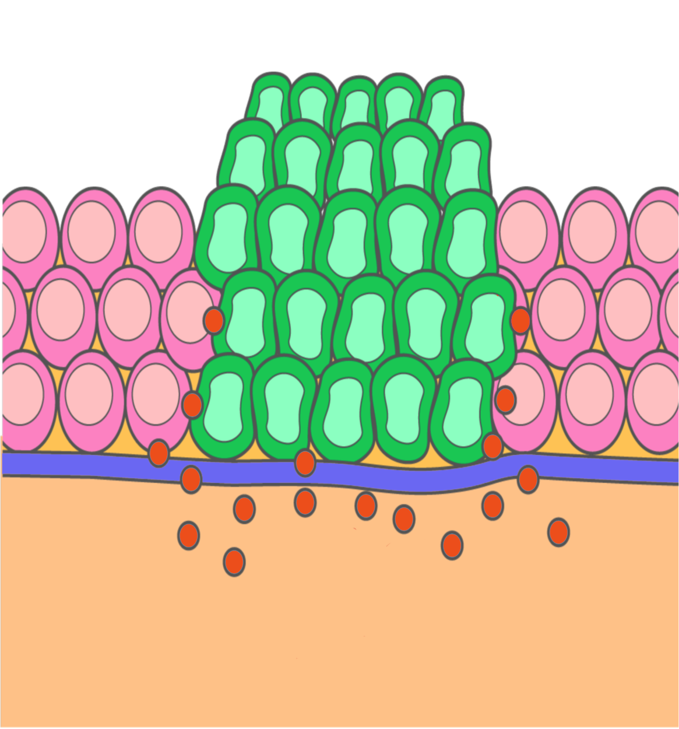
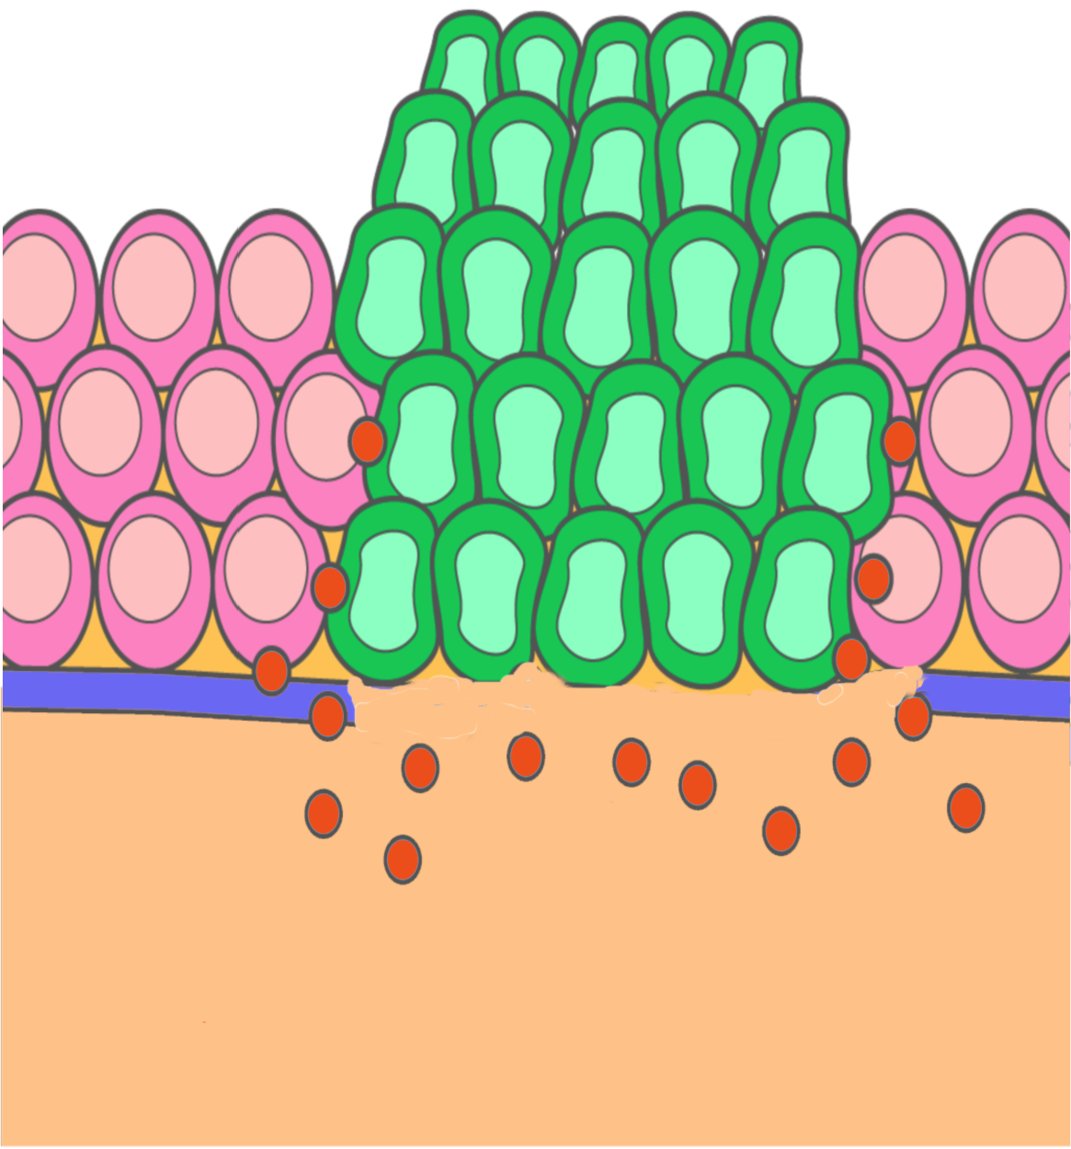
Cancer cells secrete proteases that break down basement membrane and stroma
Basement membrane
Proteases
Basement membrane

Slide 9
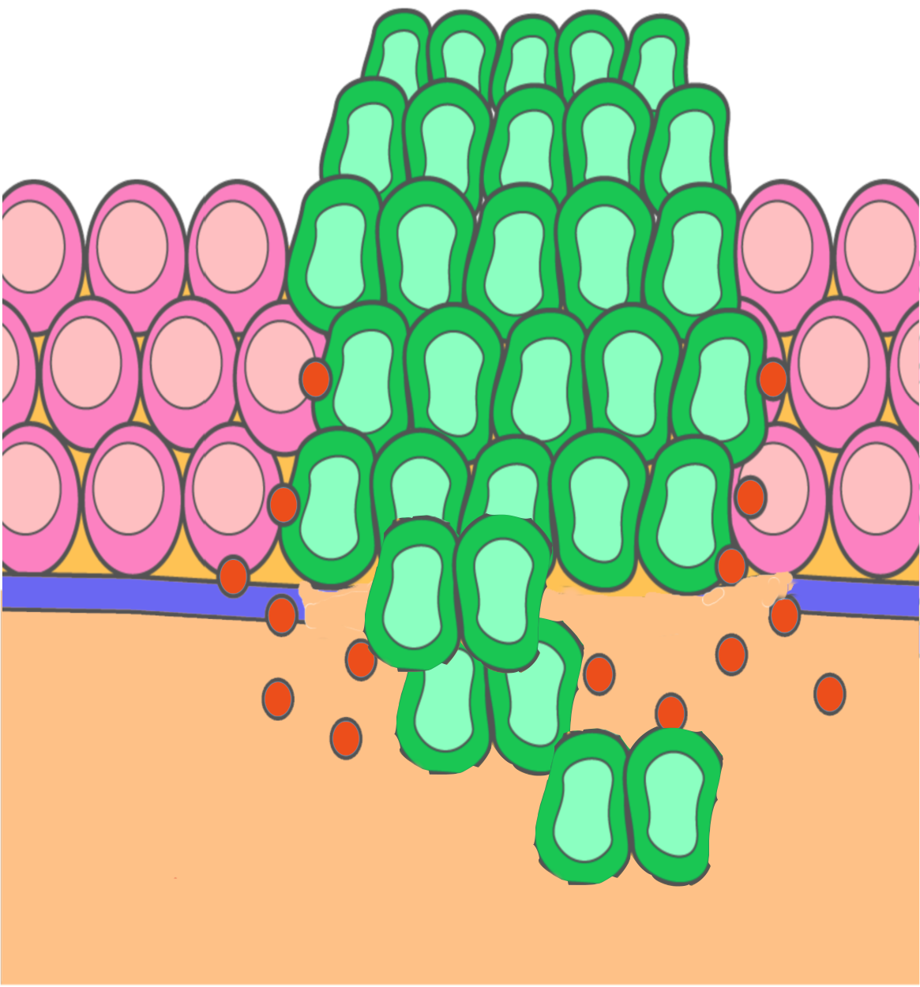
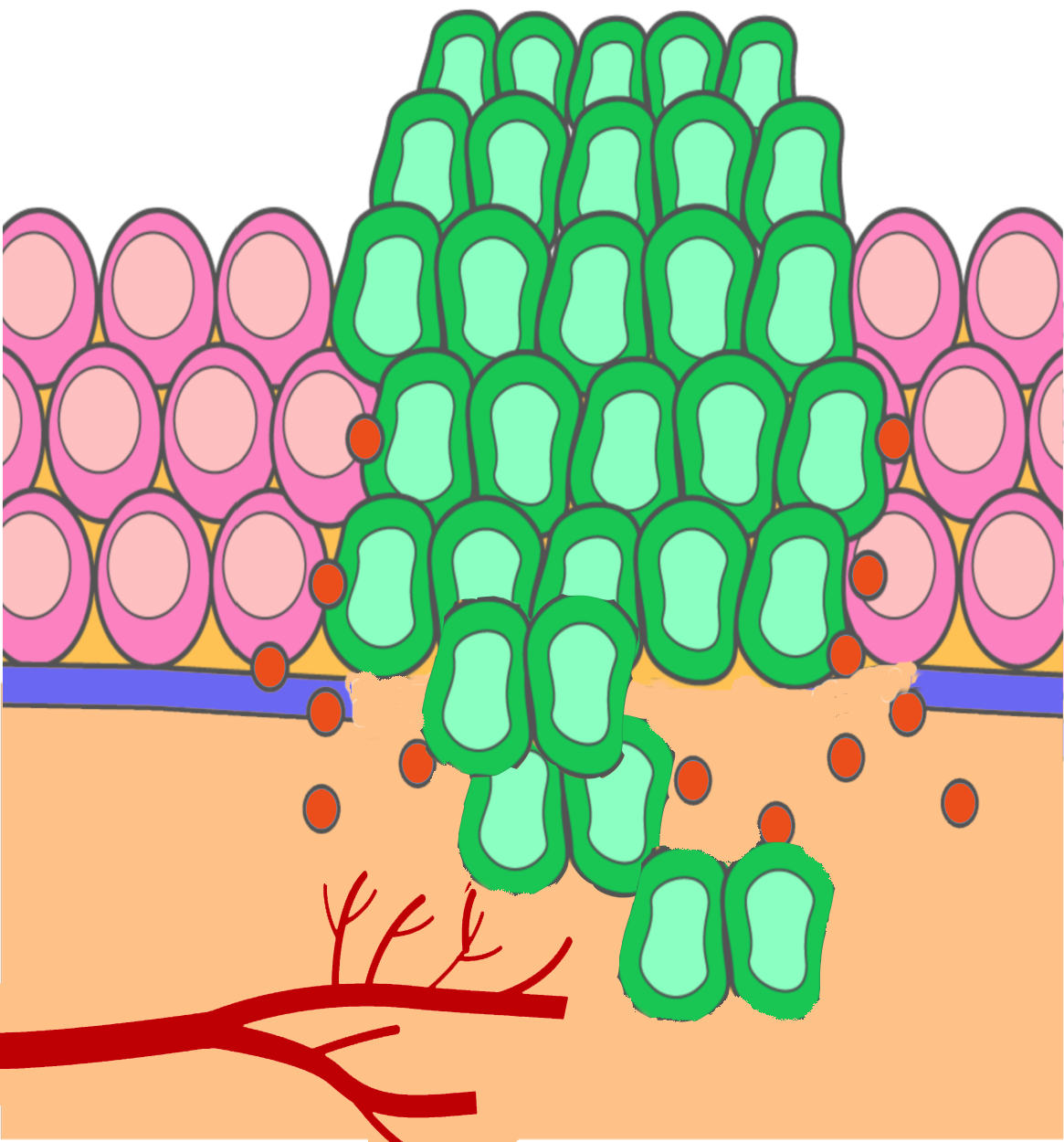
Cancer cells and blood vessels can now invade the stroma
Basement membrane
Blood vessels

Slide 10
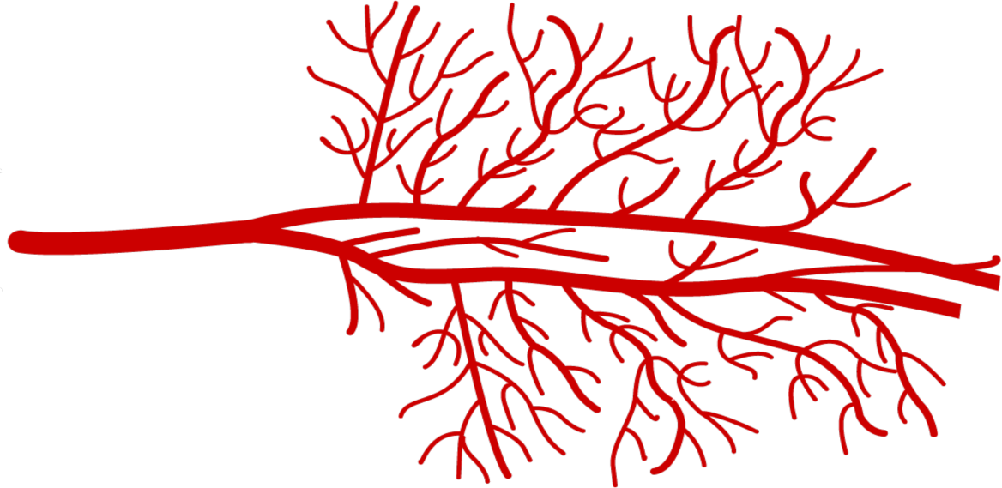
Tumors recruit blood vessels to provide nutrients
Angiogenesis –
growth of new blood vessels
Signals that promote blood vessel growth also promote lymph vessel growth

Slide 11
Activity
Invasion game!
Simulate the process of metastasis by playing a board game.

Slide 12
Wrap up: Debrief
What were the best mutations to pick up?
What happened when you landed in the lymph node?
Do cells stop mutating once they enter blood stream?

Slide 13
Traveling through the vascular highway
Entry into blood stream is dangerous!
Immune cells
Shear forces
Lymph node entrapment

Slide 14
Wrap up: Arrange these steps in metastasis
Local invasion
Entering the bloodstream (intravasation).
Exiting the bloodstream and forming a secondary tumor (extravasation).
Proliferation
Growth of new blood vessels (angiogenesis).
Notes:
Modified text

Slide 15
Wrap up: Arrange these steps in metastasis
Proliferation
Local invasion
Angiogenesis (growth of new blood vessels)
Intravasation (entering the bloodstream)
Extravasation (exiting the bloodstream) and forming secondary tumor.

Slide 16
Homework
Read the handout on how the organ of primary tumor origin, determines the types of organs that secondary tumors will form in.

